Slide 1
LCP- LEARNCYBER PLATFORM
TEST YOURSELF
Page 01

Slide 2

Contact
OUR IDEA
Problem Statement
Cyberattacks (phishing, malware, data theft) are rising every year.
Most users lack basic cybersecurity knowledge.
Professional certifications are expensive and complex for beginners.
🔹 Our Solution → LCP
LearnCyber Platform (LCP) is a one-stop solution for cybersecurity awareness.
Combines learning modules, quizzes, chatbot support, and certificates in a single platform.
🔹 Why LCP?
Beginner-friendly and accessible for students, professionals, and general users.
Free/affordable learning compared to expensive certifications.
Provides data-driven insights to track learning progress.
🔹 Vision
“With LCP, we aim to build a safer digital world by empowering users with cybersecurity awareness.”
Page 02

Slide 3

TEAM MEMBERS
Project Lead / Developer
Content Creator / Researcher
01.
Name-> Aatreyee Sen
Reg Number->24BCY10122
02.
Name-> Keshav Sharma
Reg Number->24BCE11506
Data Analyst / Visualization Expert
02.
UI/UX Designer / Tester
03.
04.
Name-> Raunak Tripathi
Reg Number-> 24BCY10057
Name-> Aryan Gupta
Reg Number->24BCE10435
Page 03

Slide 4
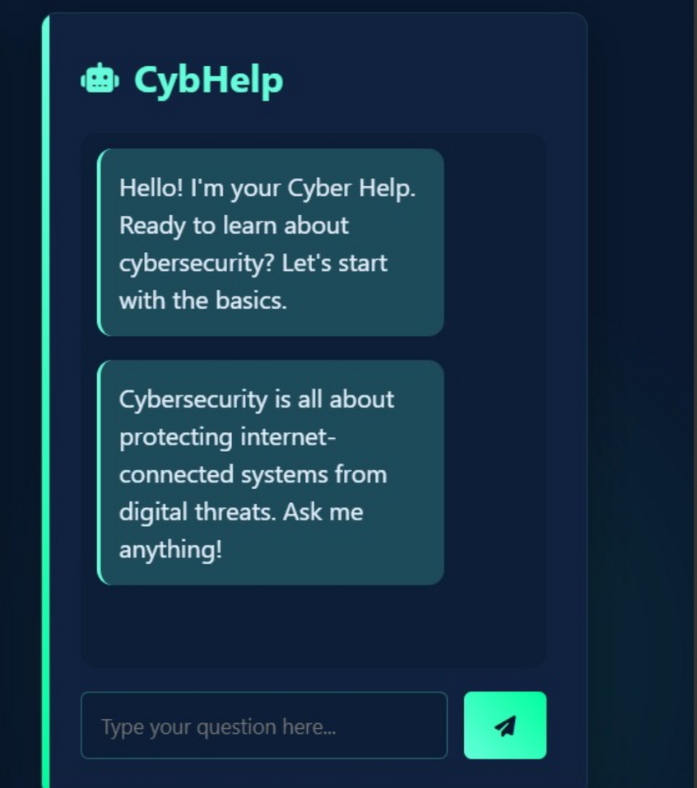
KEY FEATURES
Cybersecurity Learning Modules
Interactive Quizzes
Certificates of Completion
AI-Powered Chatbot
Secure User Login & Profiles
Page 04

Slide 5
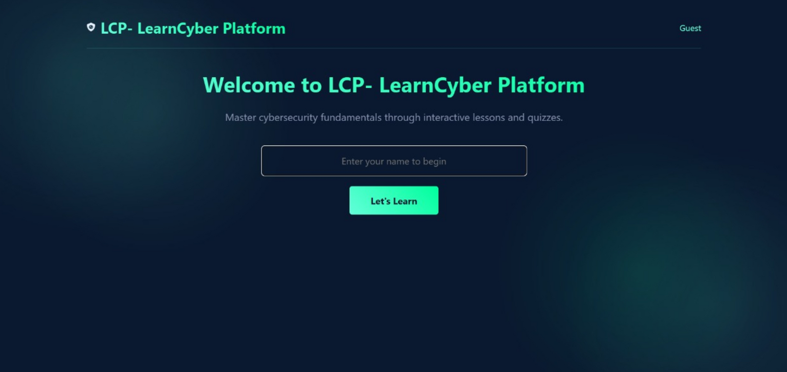
USER LOGIN PAGE
Page 05

Slide 6
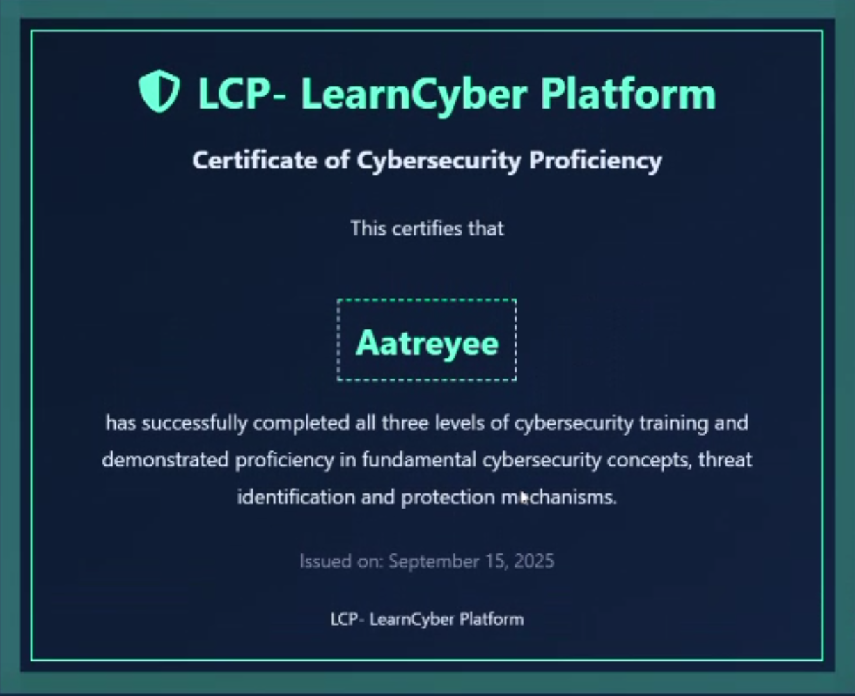
CERTIFICATE
A reward for completing cybersecurity quizzes successfully.
Encourages learners to stay motivated and finish the course.
Page 06

Slide 7


CHATBOT & KEYWORDS
Example Keywords & Responses
Password
Suggests tips for strong passwords (length, mix of characters, avoid reuse).
Warns about common mistakes (using birthdates, names, “123456”).
Phishing
Explains how fake emails/websites trick users.
Gives tips to identify phishing: suspicious links, urgent messages, spelling errors.
Malware
Defines malware (viruses, ransomware, spyware).
Shares prevention tips (antivirus, updates, avoid unknown downloads).
Cybersecurity is much more than an IT topic — it’s a business survival essential
Page 07

Slide 8
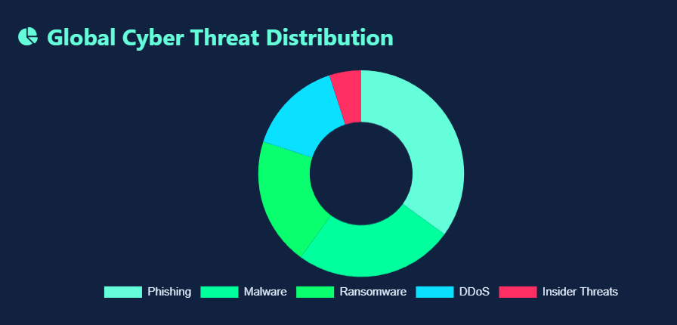
DATA VISUALIZATION MODEL
Data transforms learning into measurable growth
Data visualization helps track, measure, and improve cybersecurity learning.
Converts quiz results and user activity into clear charts and insights.
Makes it easier for learners (and admins) to understand progress.
Page 08

Slide 9

THANK YOU
FOR YOUR NICE ATTENTION
Page 09

